Slide 1

Webinar 3: IoT Analytics & Computer Vision in Industry 4.0
Intel Industrial IoT Developer Webinar Series
The webinar will begin momentarily, please wait a few moments.
If you are not yet a member, sign up to the Intel Industrial IoT Developer Community and make sure you don’t miss out on future upcoming events and exclusive information: https://intel.ly/2IYrK3E

Slide 2

Predictive Analytics & Computer Vision
Industrial IoT
Core and Visual Computing Group
Developer Relations, Intel
Notes:
Hi I’m __________
Today, I’m going to talk about the path that organizations can take to understand the evolution of analytics and different business scenarios that are driving us to better cognitive models, then we’ll talk a little about the current trends in computer vision and finally we’ll join the two area with a discussion on how machine learning and deep learning are changing these fields.

Slide 3
Legal Notices and Disclaimers
Intel technologies’ features and benefits depend on system configuration and may require enabled hardware, software or service activation. Performance varies depending on system configuration. No computer system can be absolutely secure. Check with your system manufacturer or retailer or learn more at www.intel.com.
This document contains information on products, services and/or processes in development. All information provided here is subject to change without notice. Contact your Intel representative to obtain the latest forecast, schedule, specifications and roadmaps.
Any forecasts of goods and services needed for Intel’s operations are provided for discussion purposes only. Intel will have no liability to make any purchase in connection with forecasts published in this document.
ARDUINO 101 and the ARDUINO infinity logo are trademarks or registered trademarks of Arduino, LLC.
Intel, the Intel logo, Intel Inside, the Intel Inside logo, OpenVINO, Intel Atom, Celeron, Intel Core, and Intel Movidius Myriad 2 are trademarks of Intel Corporation or its subsidiaries in the U.S. and/or other countries.
*Other names and brands may be claimed as the property of others.
Copyright 2018 Intel Corporation.
3

Slide 4

Defining Predictive Analytics
Predictive analytics is the science of classifying new observations into a set of categories on the basis of a training set of data that has observations with known category memberships.
Predictive analytics is not about predicting the future, instead it’s about constructing predictive models that compute a numerical score, on the probability that a particular observation will (or will not) occur in the future with an acceptable level of reliability
Predictive analytics can be used to prepare what-if scenarios, risk assessment and determine observations that may be considered to be outliers.
How can Predictive Analytics and Computer Vision be brought together to enable new business and scientific possibilities?
Notes:
So what is predictive analytics …

Slide 5
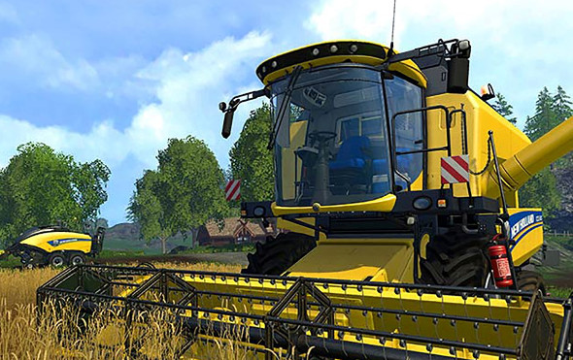

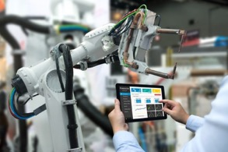
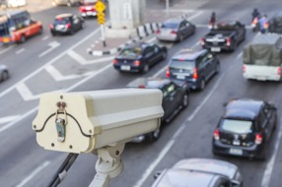

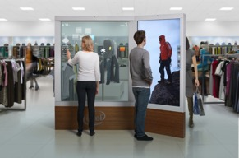
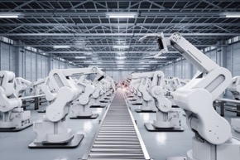
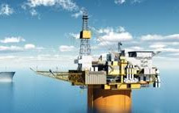
Agriculture
Transportation
Machine Vision
Cities/transportation
Predictive Modeling
Classifying and Learning building better solutions
Autonomous Vehicles
Responsive Retail
Manufacturing
Oil & GAS
Notes:
Advanced medical research, personalized healthcare, smart transportation, cities, manufacturing, retail, supply chain management—the industries that rely on video for critical insight and competitive growth are everywhere.
Up to $11 billion in edge to cloud industry growth is expected between now and 2021. Video captured at the edge by smart devices, sensors, and connected things represents a huge portion—$6 billion—of this IoT opportunity for everything from smart manufacturing to smart cities.

Slide 6
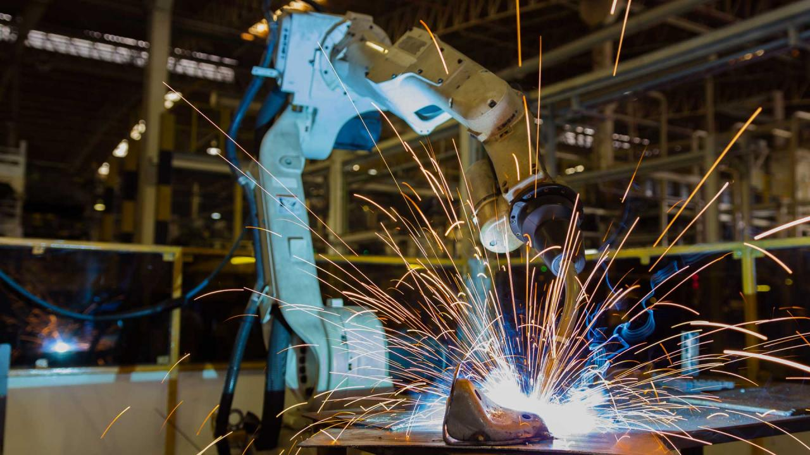
Predictive Analytics Use in Industrial Manufacturing
Fujitsu Group and Intel jointly developed a solution using sensors and video to reduce the error rate of products manufactured in their business notebook and table factories
https://www.intel.com/content/dam/www/public/us/en/documents/case-studies/real-time-iot-tracking-manufacturing-case-study.pdf

Slide 7
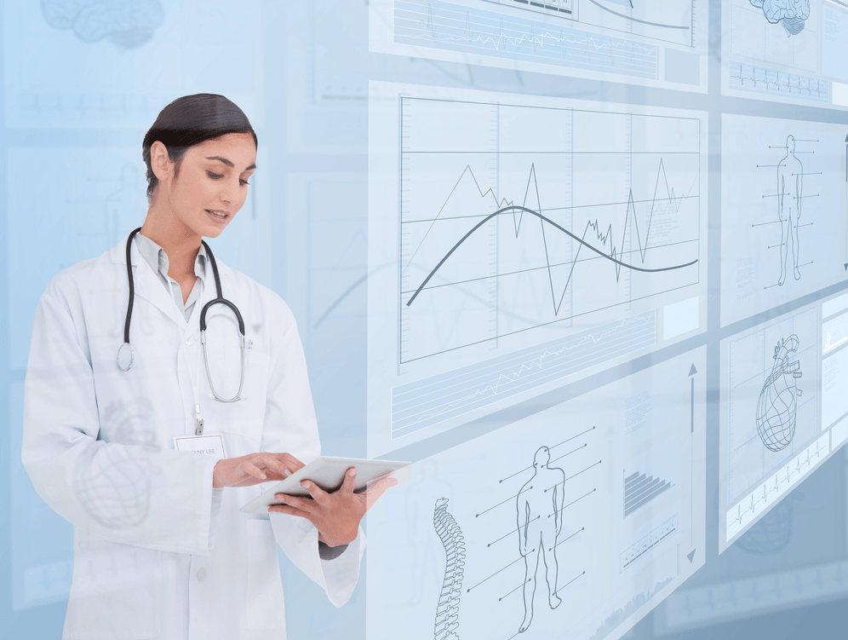
Predictive Analytics Used in Healthcare
Predictive Analytics will allow doctors, hospital administrators, researchers, and insurers to use and understand the relationships in larger data sets.
Predictors and Indicators drive nearly all decision making in this complex industry
Notes:
Further Reading:
https://www.healthcatalyst.com/predictive-analytics-healthcare-lessons/
https://www.intel.com/content/www/us/en/healthcare-it/solutions/videos/how-to-get-started-with-analytics-in-healthcare-2.html
Analytics has benefits both in on the medical and the business side of the healthcare industry.
For examples, predicting hospital readmissions is a very active topic.
Fortunately for healthcare, there are numerous existing models from other industries that are very efficient at risk stratification in the realm of population management.
Evidence-based medicine is a powerful tool to help minimize treatment variation and unexpected costs. Best-practice guidelines contribute further to the goal of standardized patient outcomes and controlling costs.

Slide 8
Analytics Maturity Curve
Technological Maturity
Cognitive Analytics
Self learning completely automated enterprise
Fewer
Assumptions
on
Distribution
Fewer
Assumptions
on
Expectation
Prescriptive Analytics
Simulation-driven and decision making
Advanced
Predictive Analytics
Foresight
Future
Present
Past
Diagnostic Analytics
Insight
Descriptive Analytics
Hindsight
Traditional
More
Assumptions
Of
Distribution
More
Assumptions
Of
Expectation
Infrastructure Opportunity
Notes:
One of the question that we often get when we start about predictive analytics is, “How do I get started?” “What does the analytics journey look like for an organization like mine?”
The great thing is that the works that all organizations have done around traditional types of analytics like descriptive and diagnostics analytics or what we think of as traditional BI, really sets the stage for more advanced types of analytics like predictive analytics.
We commonly see healthcare organization go five stages on their journey.
We call this the analytics maturity curve and the first two are stages that most healthcare organizations are doing today.
The first stage on the analytics journey is descriptive analytics, or what we commonly refer to as Business Intelligence (BI). In descriptive analytics we are storing data, about our operations, about our organization, relational database / data warehouse and we’re simply looking at the trends of that data over time.
The next thing that organizations will do is move up to diagnostic analytics. So, looking at the trends over time and based on those trends identifying opportunities to improve or provider new services based on what we’ve seen in the past.
The third stage in the maturity model is where we move from what we call traditional analytics. With predictive analytics we’re not looking at what happened in the past, we’re using the data that we have about the past to build models that allow us to predict what will happen in the future for certain target events. An example of this might be predicting a patient who is septic. So I might look at information about previous septic patients and, using that information about the past, I’m able to predict the probability of another patient becoming septic.
In the fourth stage we see prescriptive analytics. Prescriptive analytics bring together the best of predictive analytics abilities- what will happen in the future along with evidence base practices and history to recommend courses of action. So, this is what we think will happen, and here are some of the suggested best paths that you could take based on what we’ve seen historically.
The fifth stage of analytics maturity is cognitive analytics. Cognitive analytics looks to use technologies like artificial intelligence to streamline more of the process and to augment the work that people do.
Talk about the Y axis
Now the term technological maturity is a rather vague idea which we could break out into a number of features. In other words, in this 2d space, we can talk about a multi-variable set of relations.
The first is event time. Is the data is analyzing events in the past, the present or the future.
The second is descriptive of the types of algorithms that are used and the assumption that we need to make about the distribution of the data. We will talk more about Parametric vs non-parametric algorithms in a moment.
The third is a progression from algorithms that result in know expectation states vs algorithms that define their own expectation states. We will also talk more about supervised vs. unsupervised learning in moment.

Slide 9
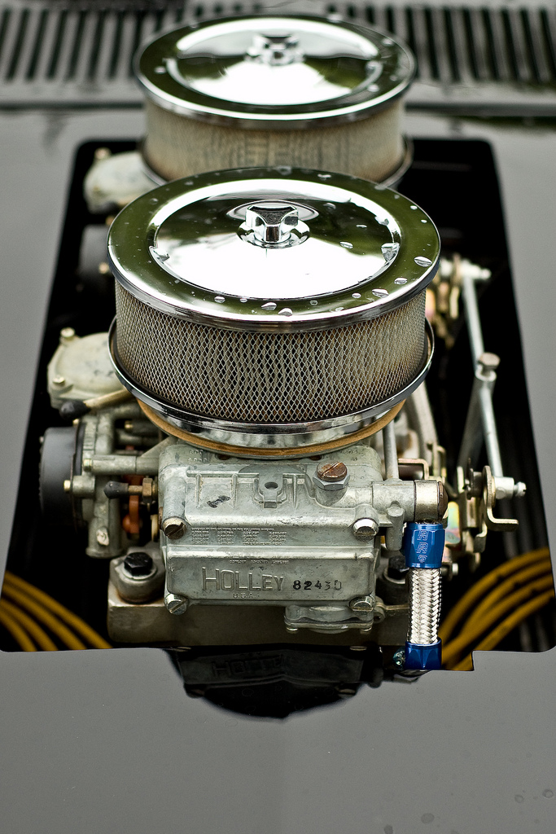
Vibration on a Motor
The vibration of mechanical parts within industrial equipment can be analyzed by decomposing their waveform into component waveforms using the Fast Fourier Transform.
As the bearing wears the ball begins to slip rather than roll. The waveform then is non-periodic but becomes cyclostationary.
The vibration status is often a predictor of the quality and so is used for estimating the lifespan of the ball bearing.
The FFT can breakdown the waveform and be used to detect when cyclic slippage begins to occur on the bearings.
Notes:
The vibration of mechanical parts within industrial equipment can be analyzed by decomposing their waveform into component waveforms using the Fast Fourier Transform.
Ball Bearings, for example, when working in perfect order produces a stationary vibration waveform that does not decompose. However, as the bearing wears the ball begins to slip rather than roll. The waveform then is non-periodic and becomes cyclostationary, meaning there is an interruption of the normal waveform that occur on a cyclic base.
The vibration status is often perceived to be synonymous with quality and thus used for predictive maintenance before breakdown. As a result, the analysis of vibration has been used as a key condition tool for fault detection, diagnosis, and prognosis. Any defect in a bearing causes some vibration that consists of certain frequencies depending on the nature and location of the defect. Although many techniques for time–frequency analysis are reported to measure vibration signals, they were found less efficient in practical applications. For this reason, this article develops an on-line bearing vibration detection and analysis using enhanced fast Fourier transform algorithm. The relation between major vibration frequency and dispersed leakage caused from fast Fourier transform can be induced, and it is then used to establish a mathematical model to find major frequencies of vibration signal.
Any waveform is actually just the sum of a series of simple sinusoids of different frequencies, amplitudes, and phases. A Fourier series is that series of sine waves; and we use Fourier analysis or spectrum analysis to deconstruct a signal into its individual sine wave components. The result is acceleration/vibration amplitude as a function of frequency, which lets us perform analysis in the frequency domain (or spectrum) to gain a deeper understanding of our vibration profile. Most vibration analysis will typically be done in the frequency domain.

Slide 10
CRISP-DM: An Approach to Understanding Data
Understanding the Business
Data Preparation
Data Modeling
Evaluation and Deployment
Understanding the Data
CRISP-DM stands for Cross-industry standard process for data mining, and it is a standard based upon a wide poll of industry data scientists.
CRISP-DM break the process of data mining into several distinct steps.
CRISP-DM notes that the data mining is a process of continuous improvement and that is continues even after a solution is deployed
Notes:
Major phases of CRISP-DM
CRISP-DM breaks the process of data mining of six major phases.
The sequence of the phases is not strict and moving back and forth between different phases is always required. The arrows in the process diagram indicate the most important and frequent dependencies between phases. The outer circle in the diagram symbolizes the cyclic nature of data mining itself. A data mining process continues after a solution has been deployed. The lessons learned during the process can trigger new, often more focused business questions and subsequent data mining processes will benefit from the experiences of previous ones.
Business Understanding
This initial phase focuses on understanding the project objectives and requirements from a business perspective, and then converting this knowledge into a data mining problem definition, and a preliminary plan designed to achieve the objectives.
Set objectives
Produce project plan
Business success criteria
Determine Business Objectives Background Business Objectives Business Success Criteria Situation Assessment Inventory of Resources Requirements, Assumptions, and Constraints Risks and Contingencies Terminology Costs and Benefits Determine Data Mining Goal Data Mining Goals Data Mining Success Criteria Produce Project Plan Project Plan Initial Assessment of Tools and Techniques
Data Understanding
The data understanding phase starts with an initial data collection and proceeds with activities in order to get familiar with the data, to identify data quality problems, to discover first insights into the data, or to detect interesting subsets to form hypotheses for hidden information.
Collect Initial Data Initial Data Collection Report Describe Data Data Description Report Explore Data Data Exploration Report Verify Data Quality Data Quality Report
Data Preparation
The data preparation phase covers all activities to construct the final dataset (data that will be fed into the modeling tool(s)) from the initial raw data. Data preparation tasks are likely to be performed multiple times, and not in any prescribed order.
Initial data collection report
Data description report
Explore data
During this stage you'll address data mining questions using querying, data visualization and reporting techniques. These may include:
Distribution of key attributes (for example, the target attribute of a prediction task)
Relationships between pairs or small numbers of attributes
Results of simple aggregations
Properties of significant sub-populations
Simple statistical analyses
Verify data quality
Data Preparation
Clean your data
Normalize your data
Integrate and Merge your data
Data Set Data Set Description Select Data Rationale for Inclusion / Exclusion Clean Data Data Cleaning Report Construct Data Derived Attributes Generated Records Integrate Data Merged Data Format Data Reformatted Data
Modeling
In this phase, various modeling techniques are selected and applied, and their parameters are calibrated to optimal values. Typically, there are several techniques for the same data mining problem type. Some techniques have specific requirements on the form of data. Therefore, stepping back to the data preparation phase is often needed.
Select Modeling Technique
Modeling Technique
Modeling Assumptions
Generate Test Design
Test Design
Build Model Parameter Settings Models
Model Description
Assess Model
Model Assessment
Revised Parameter Settings
Evaluation
At this stage in the project you have built a model (or models) that appears to have high quality, from a data analysis perspective. Before proceeding to final deployment of the model, it is important to more thoroughly evaluate the model, and review the steps executed to construct the model, to be certain it properly achieves the business objectives. A key objective is to determine if there is some important business issue that has not been sufficiently considered. At the end of this phase, a decision on the use of the data mining results should be reached.
Assessment of data mining results - Summarise assessment results in terms of business success criteria, including a final statement regarding whether the project already meets the initial business objectives.
Approved models - After assessing models with respect to business success criteria, the generated models that meet the selected criteria become the approved models.
Evaluate Results Assessment of Data Mining Results w.r.t. Business Success Criteria Approved Models Review Process Review of Process Determine Next Steps List of Possible Actions Decision
Deployment
Creation of the model is generally not the end of the project. Even if the purpose of the model is to increase knowledge of the data, the knowledge gained will need to be organized and presented in a way that is useful to the customer. Depending on the requirements, the deployment phase can be as simple as generating a report or as complex as implementing a repeatable data scoring (e.g. segment allocation) or data mining process. In many cases it will be the customer, not the data analyst, who will carry out the deployment steps. Even if the analyst deploys the model it is important for the customer to understand up front the actions which will need to be carried out in order to actually make use of the created models.
Plan Deployment Deployment Plan Plan Monitoring and Maintenance Monitoring and Maintenance Plan Produce Final Report Final Report Final Presentation Review Project Experience Documentation
Wikipedia

Slide 11
Reminders for Data Scientists
More data does not necessarily mean more insight
Increased Insight does not always mean increased value
Notes:
More data does not necessarly mean more insight: It can be difficult to extract robust and clinically relevant conclusions, even from reams of data.
Insight does not always mean value: While many solid scientific findings may be interesting, they do little to significantly improve current clinical outcomes.
Ability to interpret data varies based on the data itself: Sometimes even the best data may afford only limited insight into clinical health outcomes.
Implementation itself may prove a challenge: Leveraging large data sets successfully requires a hospital system to be prepared to embrace new methodologies; this, however, may require a significant investment of time and capital and alignment of economic interests.

Slide 12

Clearly Actionable Data
Representing data presents challenges because the data must be related to high level ideas that are actionable, timely and relevant.

Slide 13

Algorithms in the Predictive Modeling Toolkit
Notes:
Intel is transforming from a PC company to a company that powers the cloud and billions of smart, connected computing devices. These devices will use the power of Intel technology to process data being generated from “things,” connect to and learn from data being analyzed in the cloud, and deliver amazing new experiences.
As the Internet of Things evolves, we see three distinct phases emerging. The first is to make everyday objects smart – this is well underway with everything from smart toothbrushes to smart car seats now available. The second is to connect the unconnected, with new devices connecting to the cloud and enabling new revenue, services and savings. New devices like cars and watches are being designed with connectivity and intelligence built into the device. The third is just emerging when devices will require constant connectivity and will need the intelligence to make real-time decisions based on their surroundings. This is the “autonomous era,” and machine learning and computer vision will become critical for all kinds of machines.
Intel’s goal is to lead the industry in transforming businesses and the way we live by making it simple to create exciting, new IoT solutions.
(source https://newsroom.intel.com/editorials/intel-acquires-computer-vision-for-iot-automotive/)

Slide 14
What is a Predictive model?
A predictive model is formally an function that relates a set of inputs (Xs) to one or more outcomes (Ys) by separating the response variation into signal and noise.
Models are often divided into parametric and non-parametric.
Parametric models assumes the distribution of the function is defined by a bounded, or finite set of parameters (Θ). P(x|Θ, D) = P(x|Θ)
Non-parametric models assume that the data distribution is not defined in terms of such a finite set of parameters. They do But they can often be defined by assuming an infinite dimensional, Θ.
Wikipedia has a list of some types of models
Group method of data handling
Naive Bayes
k-nearest neighbor algorithm
Majority classifier
Support vector machines
Random forests
Boosted trees
CART (Classification and Regression Trees)
MARS
Neural Networks
ACE and AVAS
Ordinary Least Squares
Generalized Linear Models (GLM)
Logistic regression
Generalized additive models
Robust regression
Semiparametric regression

Slide 15
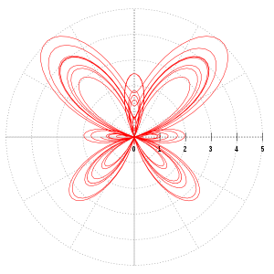
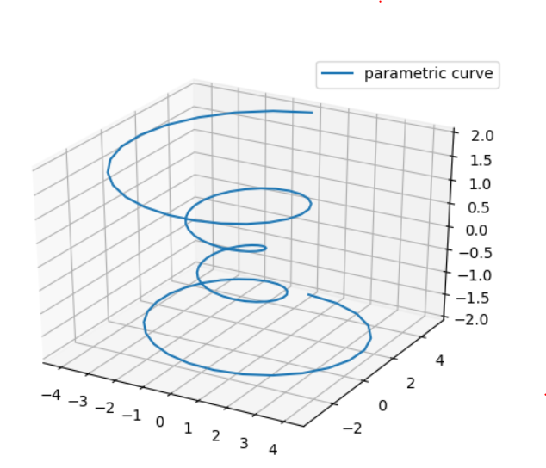
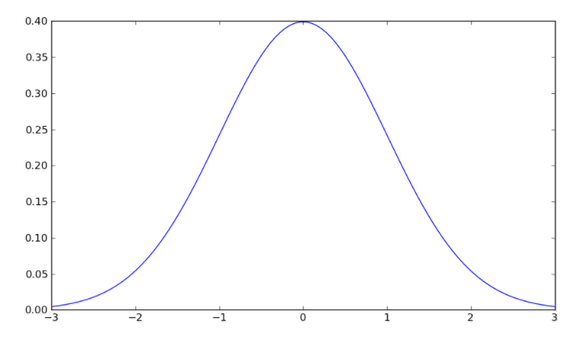
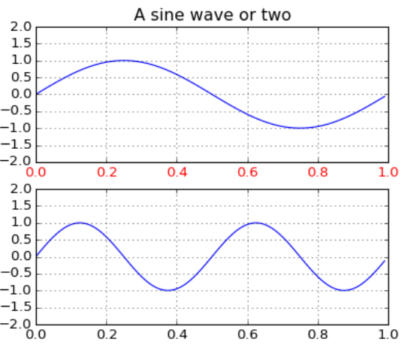
Parametric Vs Non-Parametric
Parametric models - assumes the distribution of the function is defined by a bounded, or finite set of parameters (Θ). P(x|Θ, D) = P(x|Θ)
Non-parametric models - assume that the data distribution is not defined in terms of such a finite set of parameters. They do But they can often be defined by assuming an infinite dimensional, Θ.
LOWESS (locally weighted scatterplot smoothing)
Notes:
Nonparametric regression is a category of regression analysis in which the predictor does not take a predetermined form but is constructed according to information derived from the data. Nonparametric regression requires larger sample sizes than regression based on parametric models because the data must supply the model structure as well as the model estimates.

Slide 16

Three styles of Machine Learning
Supervised Learning
Supervised Learning algorithms have an outcome that is predicted from a given set of predictors. A function is generated that map inputs to desired outputs and training process continues until the model achieves a desired level of accuracy on the training data.
Unsupervised Learning
In this model there is no labelled target data. The algorithm clusters the data around pre-existing or attributes that are defined during the training.
Reinforcement Learning
Training is done to learn specific target outputs and then algorithm is exposed to an environment where it trains itself continually using trial and error. The algorithm evaluates its performance and modifies its behavior to make accurate decisions.

Slide 17
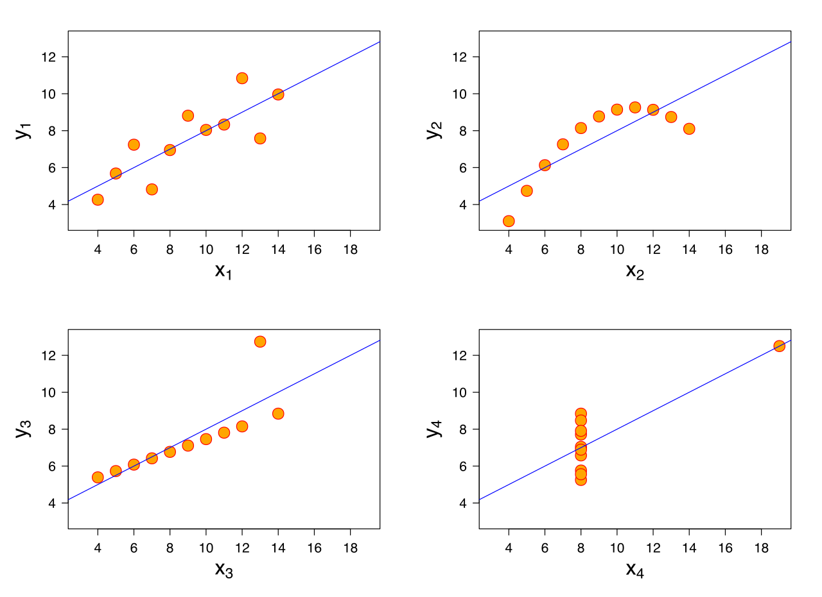

Regression algorithms
Regression analysis is a statistical processes for estimating the relationships between a dependent variable and one or more independent variables (or 'predictors').
Given a training set:
Z – {{x₁, y₁}, …, {x_{n}, y_{n}} where xi are features and yi are targets.
The goal is to find f(x) using training so that:
min $\sum_{\left(x,y\right)}{(\left(f\left(x\right)−y\right)2}$
Find the function that minimizes the square of the error.
Image from https://en.wikipedia.org/wiki/Anscombe%27s_quartet Creative Commons Attribution-ShareAlike License

Slide 18
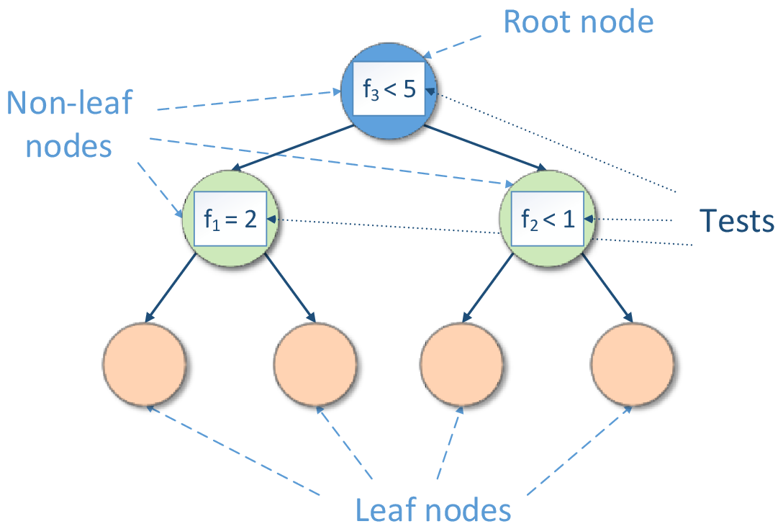
Decision Tree Learning
The goal of decision tree learning is to construct a hierarchical set of rules that classify data into discreet labeled classes
It is a type of supervised learning algorithm that is mostly used for classification problems.
Often used in rule base systems and it works well on category based and continuously dependent variables

Slide 19

K - Nearest neighbor algorithm
In k-NN classification, the output is a class membership. An object is classified by a majority vote of its neighbors, with the object being assigned to the class most common among its k nearest neighbors (k is a positive integer, typically small). If k = 1, then the object is simply assigned to the class of that single nearest neighbor.
K is the number of neighbors to consider when labelling.
https://en.wikipedia.org/wiki/K-nearest_neighbors_algorithm Creative Commons Attribution-ShareAlike License

Slide 20
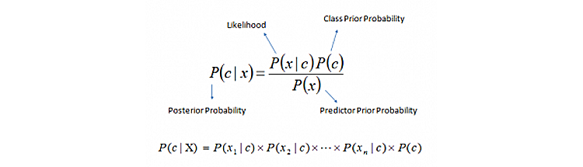
Naïve Bayes
A Naive Bayes classifier uses the conditional probability assumes that the predictors used to classify incoming data points are independent of each other.
Performs well when the dimensionality of the inputs is high
Humidity | Temperature | Wind Speed | Weather
Humid | Hot | Fast | Sunny
Humid | Hot | Fast | Sunny
Humid | Hot | Slow | Sunny
Not Humid | Cold | Fast | Sunny
Not Humid | Hot | Slow | Rainy
Not Humid | Cold | Fast | Rainy
Humid | Hot | Slow | Rainy
Humid | Cold | Slow | Rainy
Recommendation System: Naive Bayes classifiers are used in various inferencing systems for making certain recommendations to users out of a list of possible options.
Real-Time Prediction: Naive Bayes is a fast algorithm, which makes it an ideal fit for making predictions in real time.
Multiclass Prediction: This algorithm is also well-known for its multiclass prediction feature. Here, we can predict the probability of multiple classes of the target variable.
Sentiment Analysis: Naive Bayes is used in sentiment analysis on social networking datasets like Twitter* and Facebook* to identify positive and negative customer sentiments.
Text Classification: Naive Bayes classifiers are frequently used in text classification and provide a high success rate, as compared to other algorithms.
Spam Filtering: Naive Bayes is widely used in spam filtering for identifying spam email.
Humidity % | Temp (C) | Wind | Weather
Humid | Cold | Fast | ?
Notes:
Here,
P(c|x): posterior probability of class(c,target) given predictor(x,attributes). This represents the probability of c being true, provided x is true.
P(c): is the prior probability of class. This is the observed probability of class out of all the observations.
P(x|c): is the likelihood which is the probability of predictor-givenclass. This represents the probability of x being true, provided x is true.
P(x): is the prior probability of Humidity %Temperature (C)Wind Speed (Km/h)WeatherHumidColdFast?predictor. This is the observed probability of predictor out of all the observations.
Recommendation System: Naive Bayes classifiers are used in various inferencing systems for making certain recommendations to users out of a list of possible options.
Real-Time Prediction: Naive Bayes is a fast algorithm, which makes it an ideal fit for making predictions in real time.
Multiclass Prediction: This algorithm is also well-known for its multiclass prediction feature. Here, we can predict the probability of multiple classes of the target variable.
Sentiment Analysis: Naive Bayes is used in sentiment analysis on social networking datasets like Twitter* and Facebook* to identify positive and negative customer sentiments.
Text Classification: Naive Bayes classifiers are frequently used in text classification and provide a high success rate, as compared to other algorithms.
Spam Filtering: Naive Bayes is widely used inspam filtering for identifying spam email.

Slide 21

Gradient Boosting Algorithms
Boosting algorithms are used to combine a series of weak classifiers into a more robust classifer model.
Input: training set {{x₁, y₁}, …, {x_{n}, y_{n}}
M: The number of iterations
f₀(x) = $\frac{1}{n}\sum_{i=1}^{n}{yi}$
Iterate loop m=1 to M
$y1i$ = $yi$ – f_{m-1}(x$i$) # Calculate the residual
Fit a decision tree h_{m}(x) to the targets
fm(x) = f_{m-1} (x) + h_{m} (x)
Return f_{m}(x)
Notes:
Residual is a difference between the target and the prediction.

Slide 22
Dimensionality Reduction Algorithms
Benefits of Reducing the Number of Dimension or Features in a Data Set
Removal of multi-collinearity improves the performance of the machine learning model.
Reduction of time and storage space requirements
Improves the ability to create datasets from existing data
It becomes easier to visualize the data when reduced to very low dimensions such as 2D or 3D.
Methods of Reducing
Principal component analysis (PCA)
Low Variance
High Correlation
Notes:
The main linear technique for dimensionality reduction, principal component analysis, performs a linear mapping of the data to a lower-dimensional space in such a way that the variance of the data in the low-dimensional representation is maximized. In practice, the covariance (and sometimes the correlation) matrix of the data is constructed and the eigenvectors on this matrix are computed. The eigenvectors that correspond to the largest eigenvalues (the principal components) can now be used to reconstruct a large fraction of the variance of the original data. Moreover, the first few eigenvectors can often be interpreted in terms of the large-scale physical behavior of the system^{[citation needed][why?]}. The original space (with dimension of the number of points) has been reduced (with data loss, but hopefully retaining the most important variance) to the space spanned by a few eigenvectors.

Slide 23
Analytics Maturity Curve: Neural Networks
Technological Maturity
Cognitive Analytics
Self learning completely automated enterprise
Prescriptive Analytics
Simulation-driven and decision making
Neural Networks are increasing used higher on the Analytics Maturity Curve
Advanced
Predictive Analytics
Foresight
Diagnostic Analytics
Insight
Descriptive Analytics
Hindsight
Traditional
Infrastructure Opportunity
Notes:
We commonly see healthcare organization go five stages on their journey.
We call this the analytics maturity curve and the first two are stages that most healthcare organizations are doing today.
The first stage on the analytics journey is descriptive analytics, or what we commonly refer to as Business Intelligence (BI). In descriptive analytics we are storing data, about our operations, about our organization, relational database / data warehouse and we’re simply looking at the trends of that data over time.
The next thing that organizations will do is move up to diagnostic analytics. So, looking at the trends over time and based on those trends identifying opportunities to improve or provider new services based on what we’ve seen in the past.
The third stage in the maturity model is where we move from what we call traditional analytics. With predictive analytics we’re not looking at what happened in the past, we’re using the data that we have about the past to build models that allow us to predict what will happen in the future for certain target events. An example of this might be predicting a patient who is septic. So I might look at information about previous septic patients and, using that information about the past, I’m able to predict the probability of another patient becoming septic.
In the fourth stage we see prescriptive analytics. Prescriptive analytics bring together the best of predictive analytics abilities- what will happen in the future along with evidence base practices and history to recommend courses of action. So, this is what we think will happen, and here are some of the suggested best paths that you could take based on what we’ve seen historically.
The fifth stage of analytics maturity is cognitive analytics. Cognitive analytics looks to use technologies like artificial intelligence to streamline more of the process and to augment the work that people do.
Talk about the Y axis
Now the term technological maturity is a rather vague idea which we could break out into a number of features. In other words, in this 2d space, we can talk about a multi-variable set of relations.
The first is event time. Is the data is analyzing events in the past, the present or the future.
The second is descriptive of the types of algorithms that are used and the assumption that we need to make about the distribution of the data. We will talk more about Parametric vs non-parametric algorithms in a moment.
The third is a progression from algorithms that result in know expectation states vs algorithms that define their own expectation states. We will also talk more about supervised vs. unsupervised learning in moment.

Slide 24

Computer Vision at the EDGE
Sensing and interacting in real-time with the world around you.
Becoming increasingly mobile
Computing at the edge of the network enables new
possibilities

Slide 25
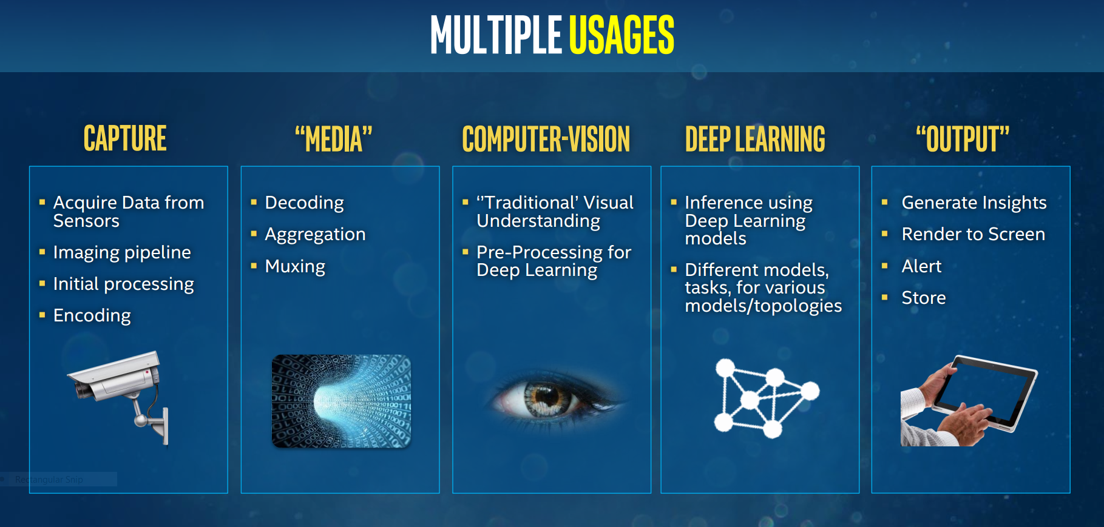

Slide 26
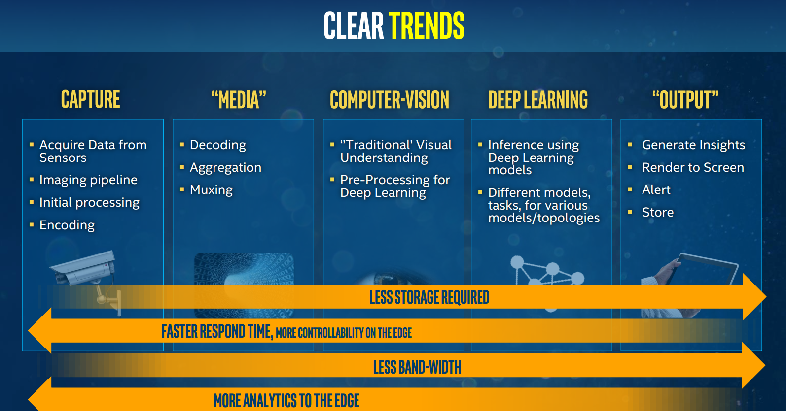

Slide 27
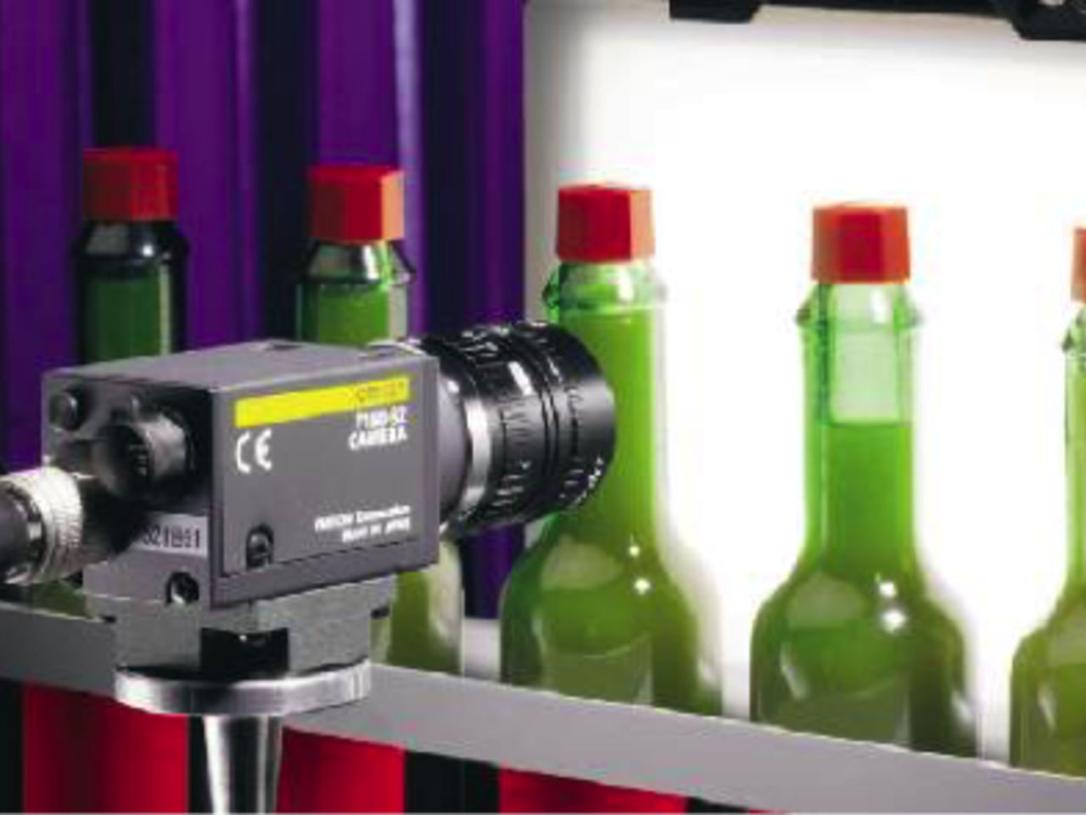
Applications of Computer Vision
Stitching/Registration
Filtering
Thresholding
Quality Assurance
Segmentation
Edge detection
Color Analysis
Blob detection and extraction
Pattern recognition
Barcode and QRC reading
Optical character recognition
Gauging/Metrology
List of algorithms is from https://en.wikipedia.org/wiki/Machine_vision Creative Commons Attribution-ShareAlike License;
Notes:
Image processing[edit]
After an image is acquired, it is processed.^{[18]} Multiple stages of processing are generally used in a sequence that ends up as a desired result. A typical sequence might start with tools such as filters which modify the image, followed by extraction of objects, then extraction (e.g. measurements, reading of codes) of data from those objects, followed by communicating that data, or comparing it against target vales to create and communicate "pass/fail" results. Machine vision image processing methods include;
Stitching/Registration: Combining of adjacent 2D or 3D images.^{[citation needed]}
Filtering (e.g. morphological filtering)^{[28]}
Thresholding: Thresholding starts with setting or determining a gray value that will be useful for the following steps. The value is then used to separate portions of the image, and sometimes to transform each portion of the image to simply black and white based on whether it is below or above that grayscale value.^{[29]}
Pixel counting: counts the number of light or dark pixels^{[citation needed]}
Segmentation: Partitioning a digital image into multiple segments to simplify and/or change the representation of an image into something that is more meaningful and easier to analyze.^{[30][31]}
Edge detection: finding object edges ^{[32]}
Color Analysis: Identify parts, products and items using color, assess quality from color, and isolate features using color.^{[6]}
Blob detection and extraction: inspecting an image for discrete blobs of connected pixels (e.g. a black hole in a grey object) as image landmarks. ^{[33]}
Neural net / deep learning processing: weighted and self-training multi-variable decision making ^{[34]}
Pattern recognition including template matching. Finding, matching, and/or counting specific patterns. This may include location of an object that may be rotated, partially hidden by another object, or varying in size.^{[35]}
Barcode, Data Matrix and "2D barcode" reading ^{[36]}
Optical character recognition: automated reading of text such as serial numbers ^{[37]}
Gauging/Metrology: measurement of object dimensions (e.g. in pixels, inches or millimeters) ^{[38]}
Comparison against target values to determine a "pass or fail" or "go/no go" result. For example, with code or bar code verification, the read value is compared to the stored target value. For gauging, a measurement is compared against the proper value and tolerances. For verification of alpha-numberic codes, the OCR'd value is compared to the proper or target value. For inspection for blemishes, the measured size of the blemishes may be compared to the maximums allowed by quality standards.^{[36]}

Slide 28

Computer Vision Algorithms
Feature Extraction
Active Contour Modeling
Blob detection
Canny edge detector
Visual Recognition
Object Recognition
Scale-invariant feature transform (SIFT)
Gesture recognition
Viola-Jones Algorithm
Kalman Filters
Edge and Corner Detection
Canny Edge Detector
Harris Corner Detector
Sobel
Notes:
Active contour model, also called snakes, is a framework in computer vision for delineating an object outline from a possibly noisy 2D image. The snakes model is popular in computer vision, and snakes are greatly used in applications like object tracking, shape recognition, segmentation, edge detection and stereo matching.
Blob detection methods are aimed at detecting regions in a digital image that differ in properties, such as brightness or color, compared to surrounding regions. Informally, a blob is a region of an image in which some properties are constant or approximately constant; all the points in a blob can be considered in some sense to be similar to each other. The most common method for blob detection is convolution.
Edge detection includes a variety of mathematical methods that aim at identifying points in a digital image at which the image brightness changes sharply or, more formally, has discontinuities. The points at which image brightness changes sharply are typically organized into a set of curved line segments termed edges.
Scale-invariant feature transform (SIFT) is an algorithm in computer vision to detect and describe local features in images. For any object in an image, interesting points on the object can be extracted to provide a "feature description" of the object. This description, extracted from a training image, can then be used to identify the object when attempting to locate the object in a test image containing many other objects. To perform reliable recognition, it is important that the features extracted from the training image be detectable even under changes in image scale, noise and illumination. Such points usually lie on high-contrast regions of the image, such as object edges.
The Viola–Jones object detection framework is the first object detection framework to provide competitive object detection rates in real-time proposed in 2001 by Paul Viola and Michael Jones.^{[1][2]} Although it can be trained to detect a variety of object classes, it was motivated primarily by the problem of face detection.
The Kadir–Brady saliency detector extracts features of objects in images that are distinct
Kalman filters are often used for object tracking using point features.
The Canny edge detector is an edge detection operator that uses a multi-stage algorithm to detect a wide range of edges in images. In general it applies Gaussian blurs to an image and then finds the intensity gradients of the image.
Sobel filter, is used in image processingand computer vision, particularly within edge detection algorithms where it creates an image emphasising edges.

Slide 29
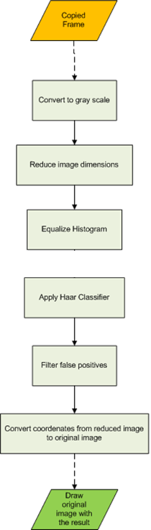

OpenCV* Library
import cv2
import numpy as np
Open Source library for computer vision
Written in C++
Bindings for most popular languages
Block-like programming structure
Image data is sequentially passed through functions
Fundamental concepts allow for powerful image processing tools
https://opencv.org/
Notes:
This is a broader overview; want to show what blocks are and how they fit in together

Slide 30
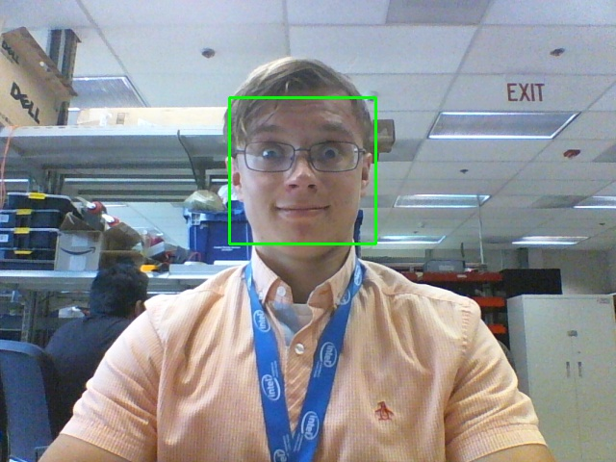
HAAR Cascades in OpenCV*
gray_img = cv2.cvtColor( img, cv2.COLOR_BGR2GRAY )
faces = cascade.detectMultiScale(
gray_img,
scaleFactor = 1.25, minNeighbors = 5,
minSize = ( 30, 30 ),
)
for (x, y, w, h) in faces:
cv2.rectangle( img, x, y, (x+w, y+h), (0, 255, 0), 2)
cascade = cv2.CascadeClassifier( ‘haarcascade_frontalface_default.xml’ )

Slide 31


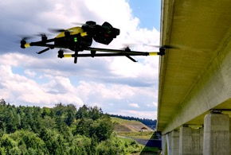
Emergency Response
Financial services
Machine Vision
Cities/transportation
Video: The “eye of IOT”
Use of video, computer vision and deep learning is growing rapidly
Autonomous Vehicles
Responsive Retail
Manufacturing
Public sector
Notes:
Advanced medical research, personalized healthcare, smart transportation, cities, manufacturing, retail, supply chain management—the industries that rely on video for critical insight and competitive growth are everywhere.
Up to $11 billion in edge to cloud industry growth is expected between now and 2021. Video captured at the edge by smart devices, sensors, and connected things represents a huge portion—$6 billion—of this IoT opportunity for everything from smart manufacturing to smart cities.

Slide 32
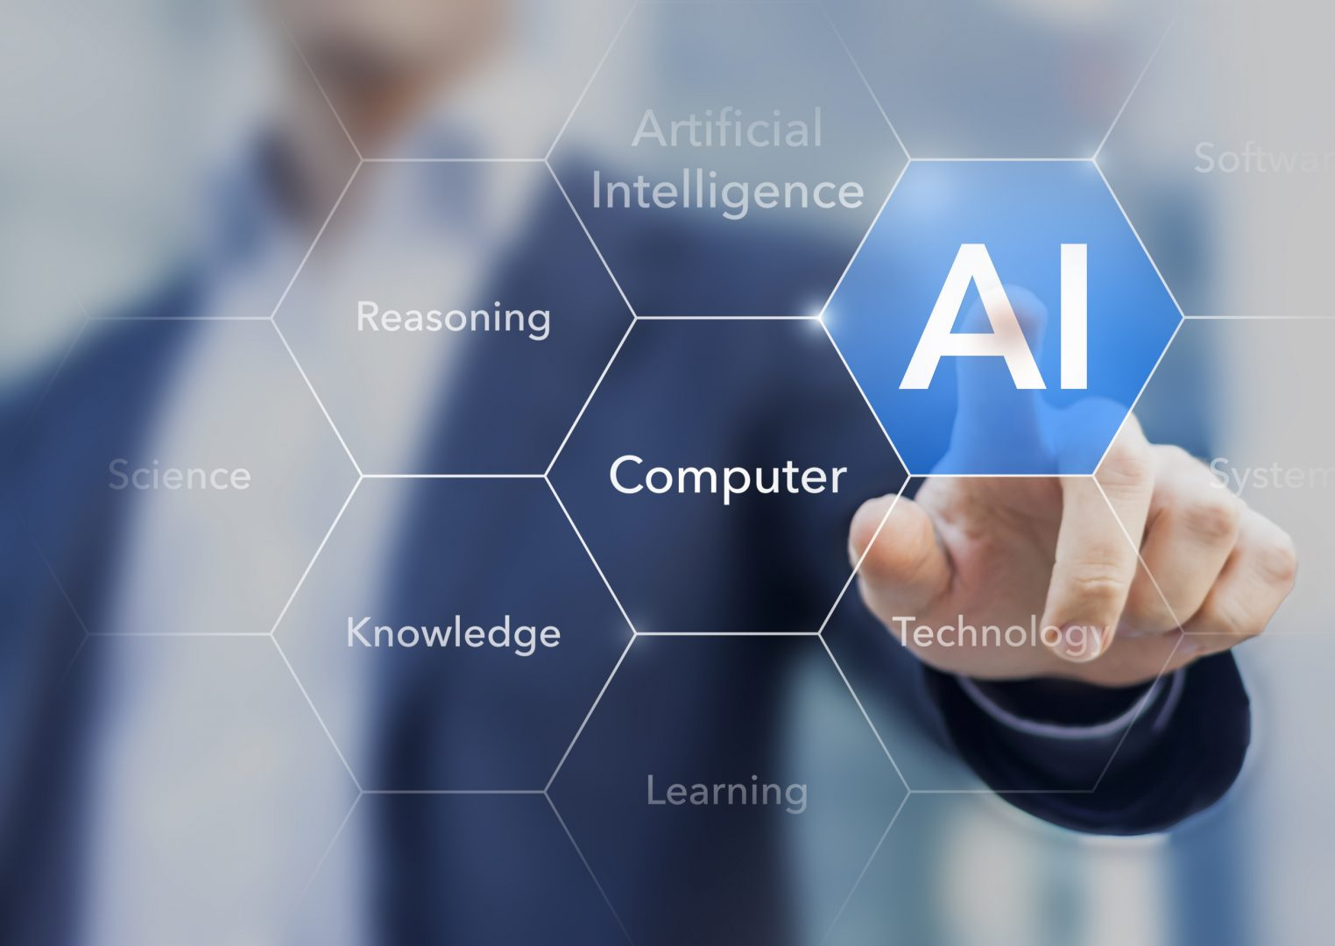
Artificial Intelligence is playing a large role in emerging predictive systems

Slide 33
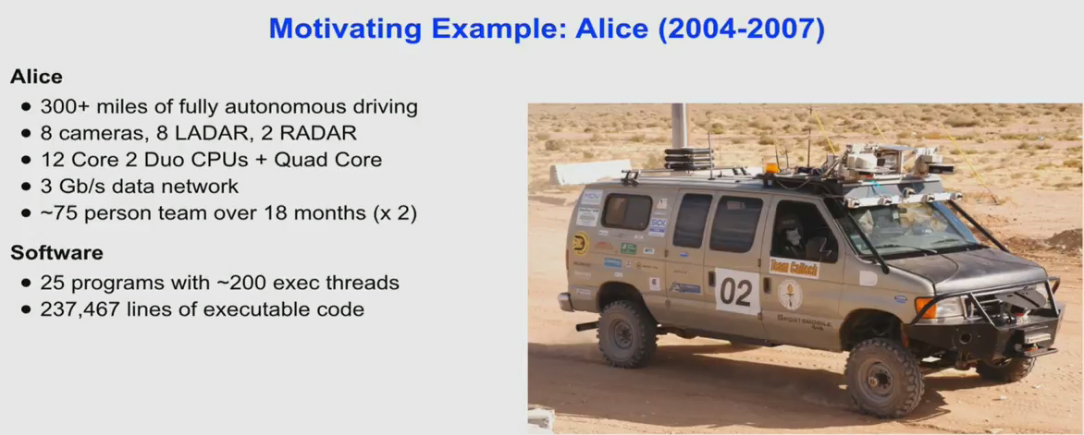
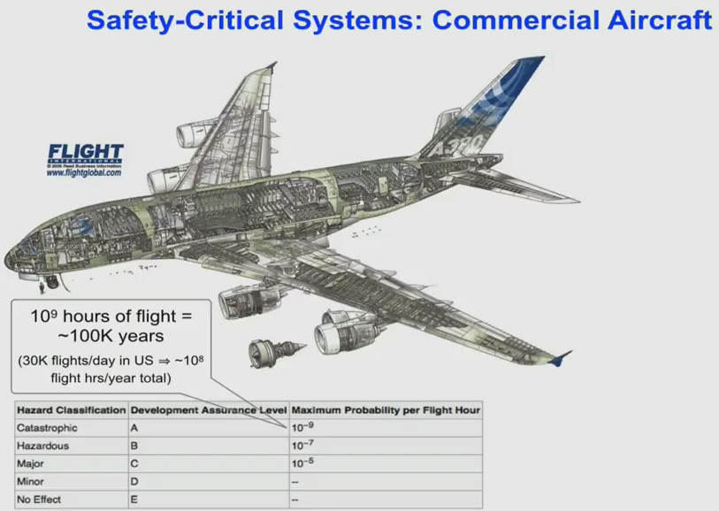
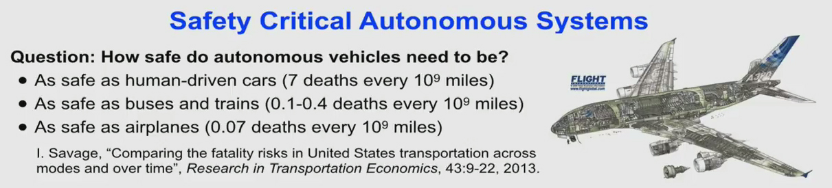
Predictive Analytics and Computer Vision NEED Compute At the Edge
3.22 trillion miles (US, 2016)
40,200 fatalities (US, 2016) – roughly 100 people each day
1 fatality per 80 million miles
1 in 625 chance of dying in car crash (in your lifetime)

Slide 34
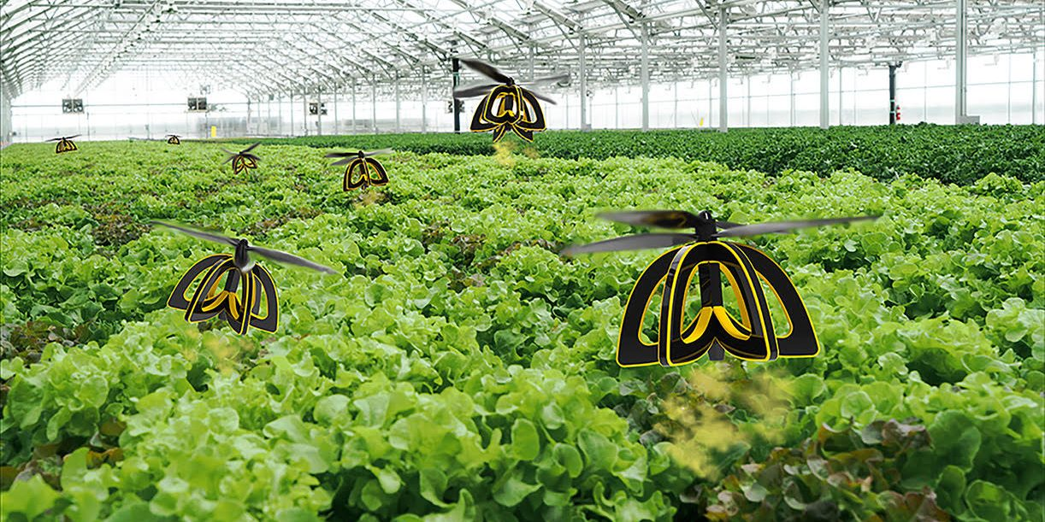
Local and distributed computational power (compute at the edge) fueled by Intel processors allow new applications and new possibilities

Slide 35
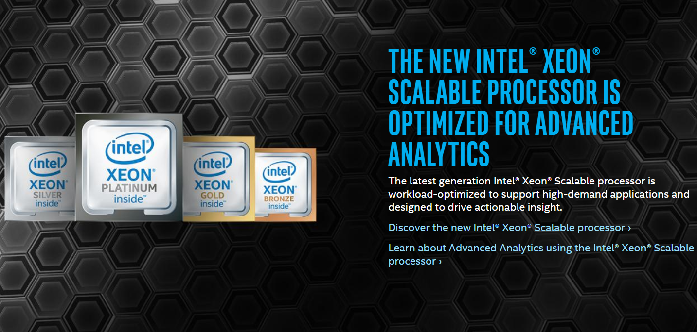

Slide 37
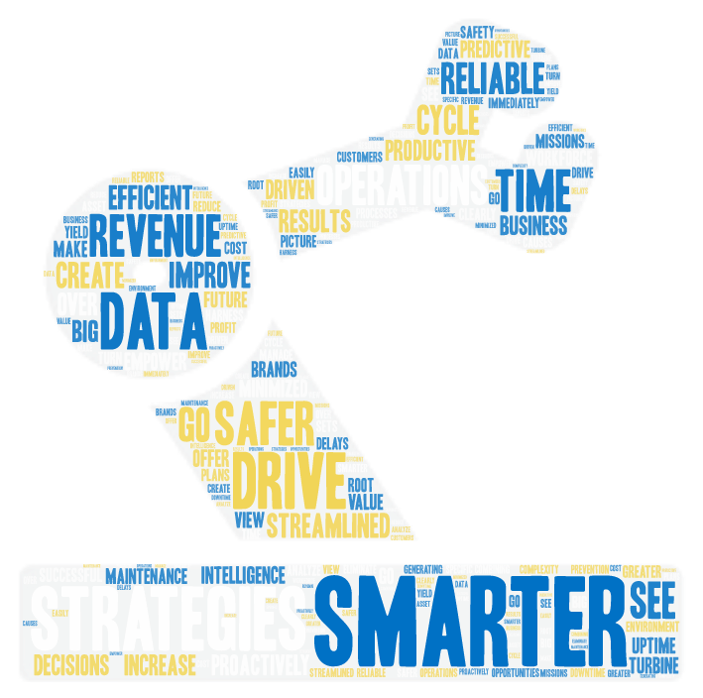
Industries and Advantage
Agriculture | Measuring eniv
Aviation
Construction
Energy
Fleet Management
Healthcare
Mining
Oil & Gas
Rail
Retail

Slide 38

Predictive Analytics

Slide 39
Industries Benefiting from predictive Analytics
Introduction
Physical Sensors and Actuators
Communications and Protocols
Control
Introduction to Intel and the IIoT
Formalized Structure to IIoT
Automated Control Systems
Security and IIoT
Operations
Each Module contains a lecture and a hands-on lab exercise that builds towards an model of an IIoT infrastructure based on a formalized architecture.
Smart Video Systems
Machine Learning
Information
Predictive Analytics
Business Analytics
Application
Notes:
IIoT Workshop Overview
This slide gives a brief outline of the material covered in the Intel Industrial IoT Workshop. You can use this slide to give a quick overview of the topics and will be covered.
You can always find the latest course outline on Github.
https://github.com/SSG-DRD-IOT/Industrial-IoT-Workshop
Topics
Introduction to the Industrial Internet of Things and the workshop including:
Overview of the topics and the hardware
What is Industry 4.0?
What business opportunities and solutions will Industry 4.0 provide?
What are the key technologies that enable new value in Industry 4.0?
Continuous Visibility into business processes by deploying physical sensors and using analytics, digital twins and machine learning creates a Virtuous Cycle.
What Pilot Opportunities can your business begin to harness the Industrial IoT
Formalizing the IIoT – We will give an overview of the Industrial Internet Consortium (IIC) and create a architecture based on their whitepapers.
Physical Sensors and Actuators – We will explore the hardware sensors in the Up2 Grove IoT Development Kit and use Arduino Create to build a couple of sensor based labs
Communications and Protocols – We will talk about scalability in a IIoT network and three protocols MQTT, OPC-UA and DDS
Automation – Reactions based on sensor data
Smart Video System – the Intel CV SDK which includes OpenVX and OpenCV as well as the deep learning kit and the inference engine.
Machine Learning, Predictive Analytics, and Business Analytics will be written for the 2 day workshop.
Industrial IoT or Industry 4.0 has arrived at the doorstep many of the industrial companies and going forward high investment will flow into new digitalization processes changing the way the industrial ecosystem will operate. This workshops is an introduction in the concepts and formal architectures of Industry 4.0. The workshop is divided into modules. Each Module contains a lecture and a hands-on lab exercise that builds towards a test prototype of an IIoT infrastructure based on the Industrial Internet Consortium’s IIoT Reference Architecture and Intel technology.
In the second module, we will introduce a formal structure for realizing an IIoT deployment. The later modules fit

Slide 40
Importance of Domain Knowledge
Depending on the available data and feature types, the performance of your predictive model can vacillate dramatically. Therefore, selecting the right features is one of the most important steps before the inferencing takes place. This is called feature engineering, which can be defined as follows:
TIP
Feature engineering
In this process, domain knowledge about the data is used to create only selective or useful features that help prepare the feature vectors to be used so that a machine learning algorithm works.

Slide 41
Statistics, Probability, and Information Theory for Predictive Modeling
random sampling, hypothesis testing, chi-square test, correlation, expectation, variance, covariance and Bayes' rule

Slide 42
EXPECTATION
The expectation of a discrete random variable is the weighted average of all values, where each value is weighted by its probability of being selected. The expected value of a random variable X is given by:

Slide 43
Central limit theorem
The central limit theorem (CLT) is one of the fundamental theorems in statistics. It states that the average of all samples of a sufficiently large sample size with independent and identically distributed variables is approximately equal to the mean of the sample space, regardless of the size of the distribution with a finite variance level.

